Slide 1

Homelab (Honeypot)
Abdul Alqarni
Cyber Systems and Components 01
Dr. Gonzalo D. Parra

Slide 2

What is honeypot
A honeypot is a cybersecurity tool designed to attract and deceive attackers. It mimics vulnerable systems or services to attract attackers away from real systems, allowing security professionals to monitor and study their tactics, techniques, and procedures.

Slide 3
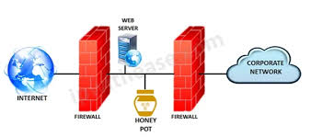

Slide 4
What is honeypot
A honeypot is a cybersecurity tool designed to attract and deceive attackers. It mimics vulnerable systems or services to attract attackers away from real systems, allowing security professionals to monitor and study their tactics, techniques, and procedures.

Slide 5
Introduction
The aim of this project is to set up a Raspberry Pi-based honeypot using the DShield Honeypot software to gather information and experiment reasons .

Slide 6
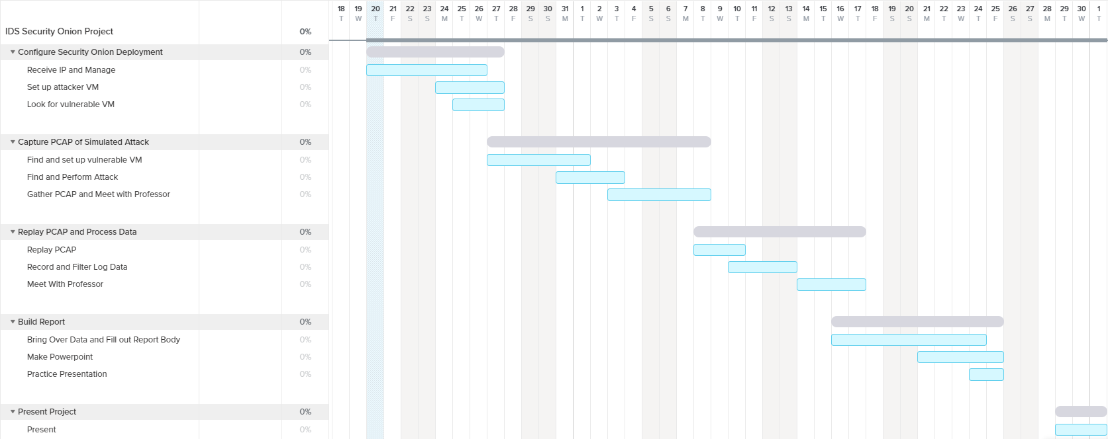
Gantt Chart

Slide 7
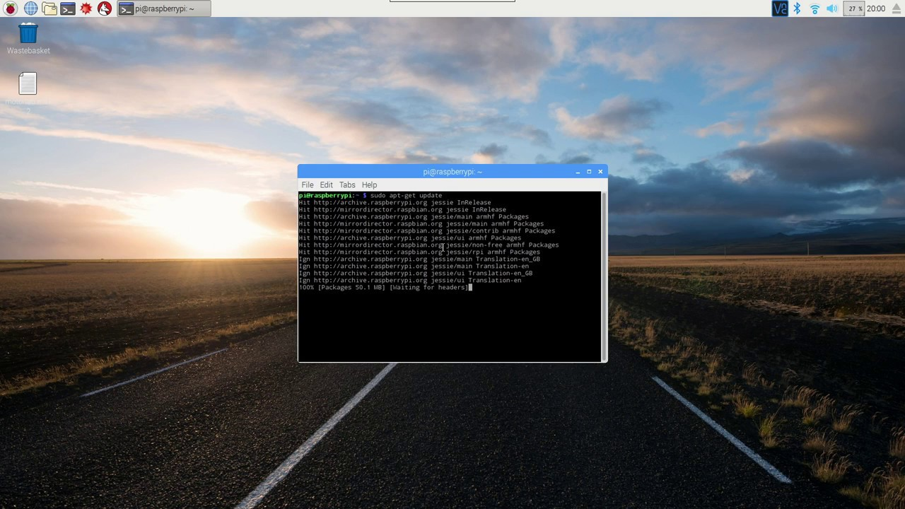
Update Raspberry Pi & Install Git
I execute this command “sudo full-upgrade” to update the Raspberry also Pi's software packages.

Slide 8
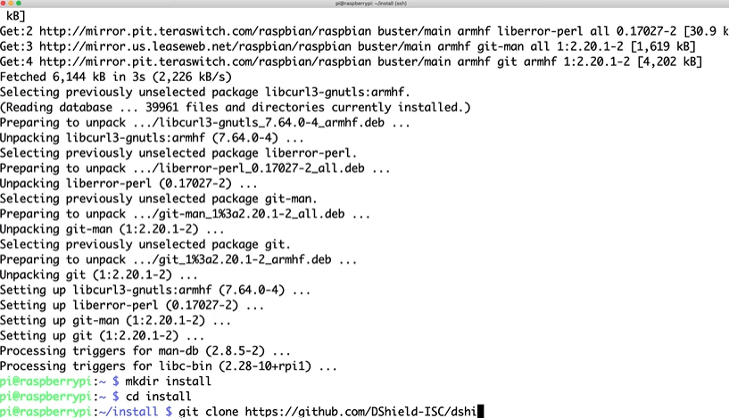
Download DShield Honeypot
Executing “so-status” to verify machine integrity
After installation Change Directories and I navigate to the dshield/bin/ directory using the command cd dshield/bin/.
And executed the installation script using the command sudo ./install.sh
GitHub, https://github.com/DShield-ISC/dshield
Before downloading make sure to create an account on there
Website ..

Slide 9
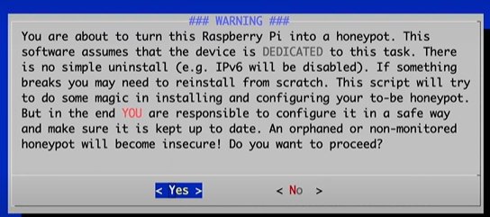
A

Slide 10
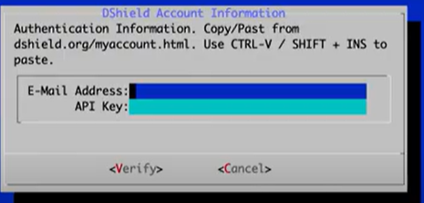
Creating an account than paste your API key during your instillation

Slide 11
Attacks reports

Slide 12
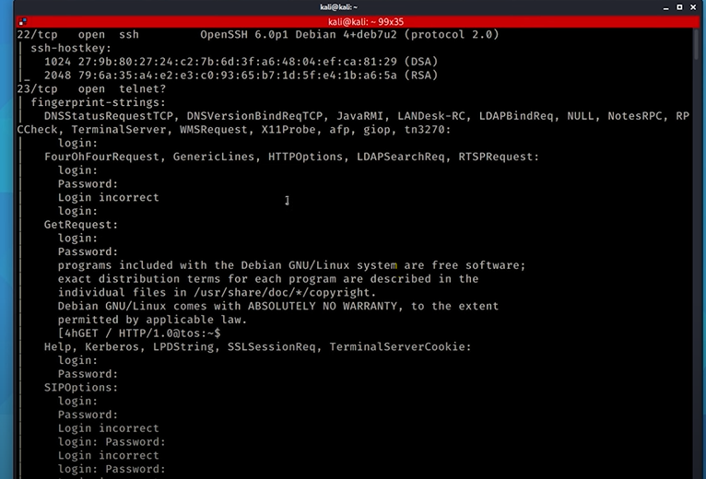
Scan against my honeypot machine using nmap: (cont.)
I used a different machine to run the scan on my honeypot using Nmap with the following command:
$nmap -Pn -A 192.168.1.117

Slide 13
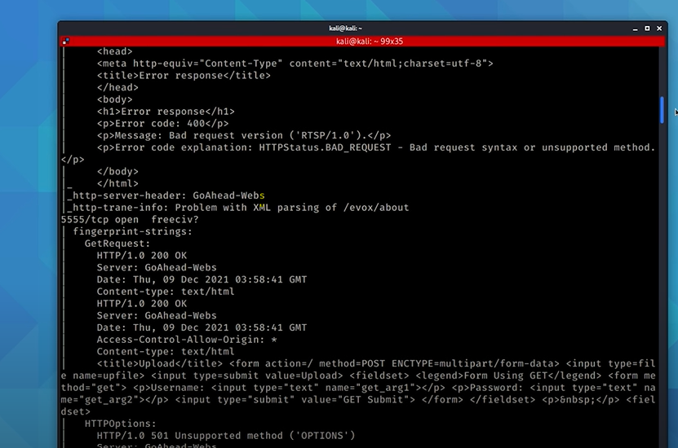
Analyzing Network Traffic (cont.)

Slide 14
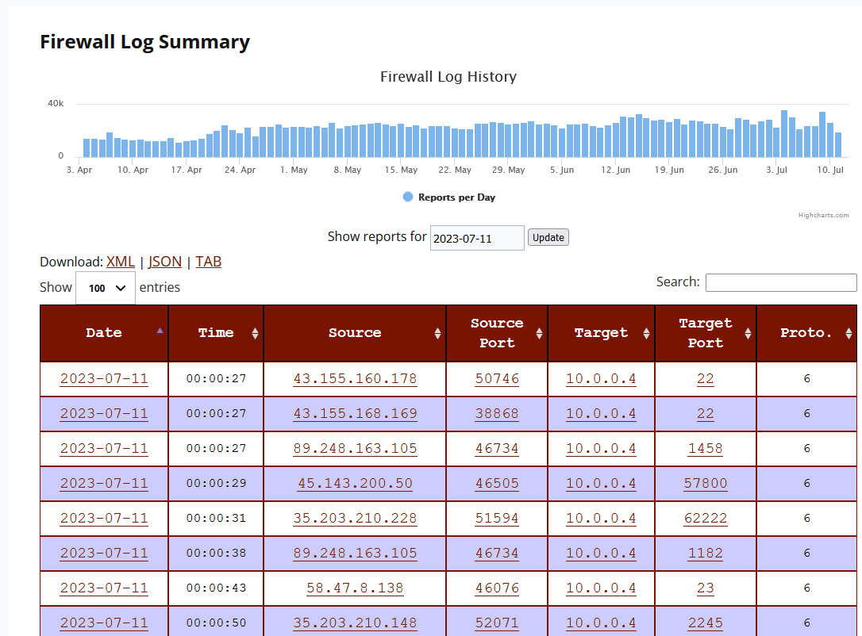
Attack simulation report

Slide 15
Conclusion
I have successfully constructed a Raspberry Pi-based honeypot utilizing the DShield Honeypot software. This project embodies a profound exploration into the realm of cybersecurity, offering a practical understanding of threat detection and mitigation

Slide 16
Any questions?
Thank you for your time!

